Slide 1

CSE 101 – Arduino Project
Group 16
Instructor: Mehmet GÖKTÜRK

Slide 2
What is the project?
Our project is a class attendance system with fingerprint sensor.

Slide 3
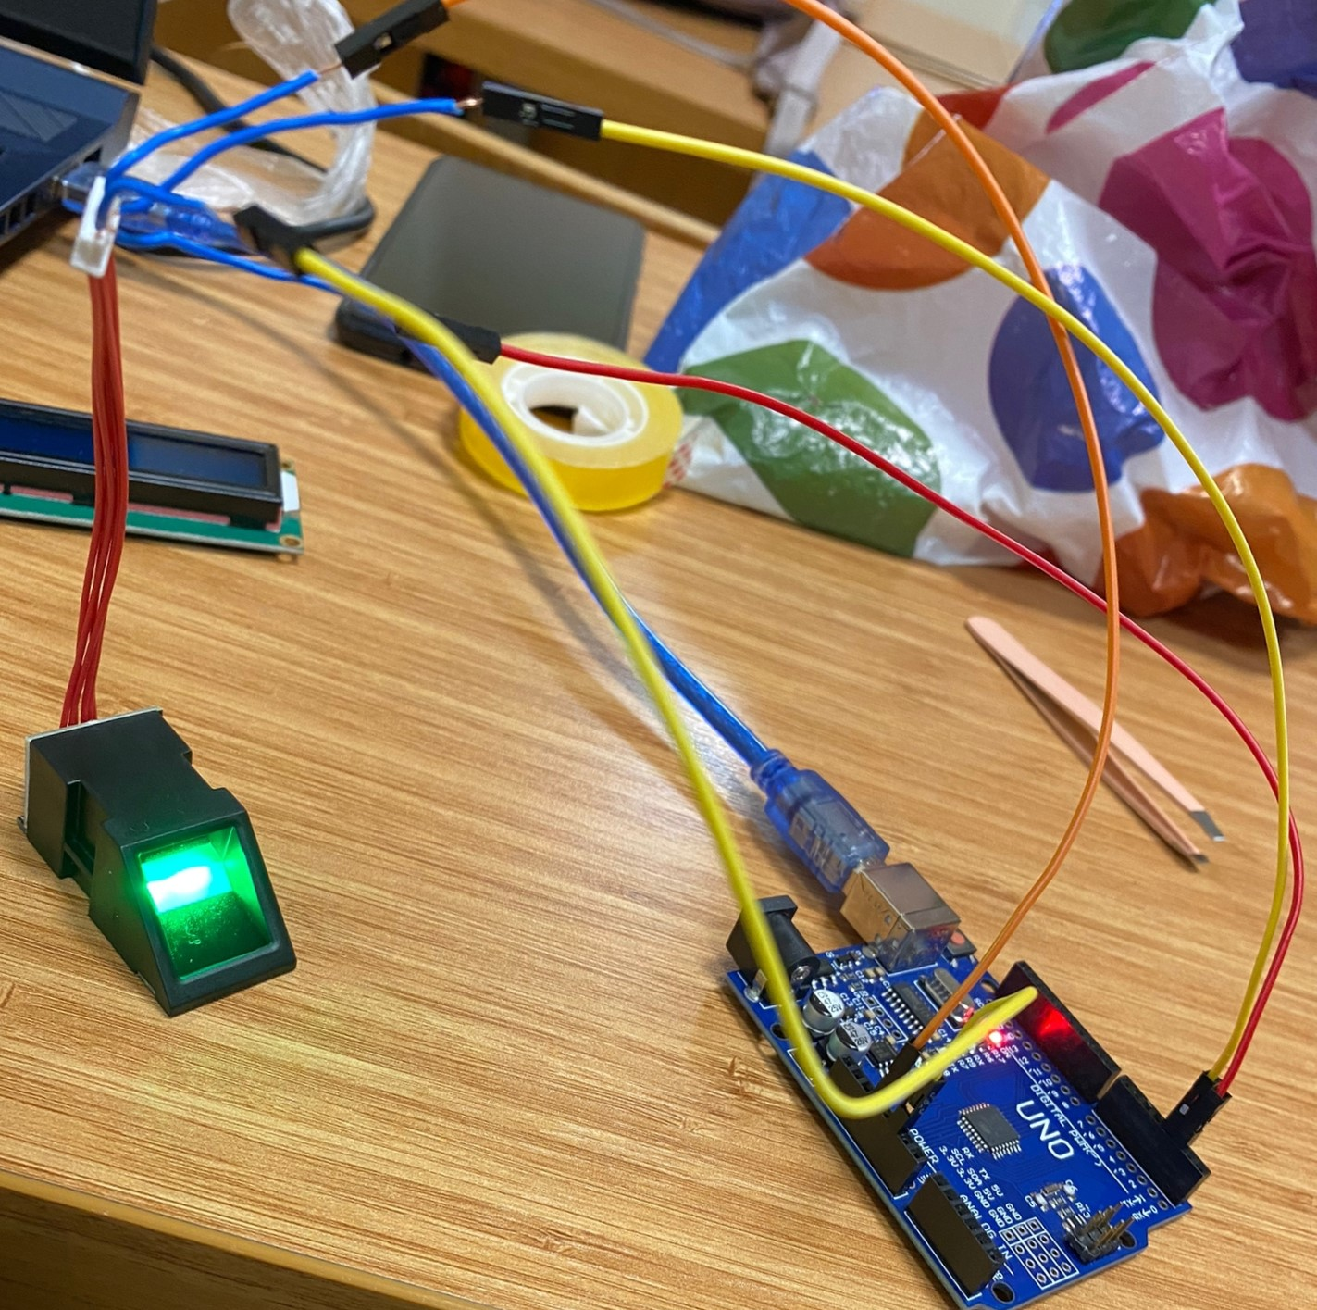
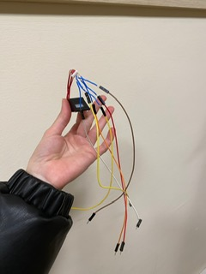
Project Description
This project uses the most reliable way of uniquely identifying students through fingerprint reading. Such type of application is very useful in school as well as in college for daily attendance.
The project requires a fingerprint reader for finger detection.
Every student can login to the system through finger detection.
The fingerprint of the student is compared with the one stored in database and if it matches then attendance is marked for that student.

Slide 4
Aims and Goals
Today, universities mostly use the paper-based system. In this project, we are aiming to digitize it and increase its security in the virtual environment.
In this project, it is aimed to design and implement a system that will track student attendance with fingerprint reading method.

Slide 5
Steps of the Project
The project has two main parts:
Equipment part
Coding part

Slide 6
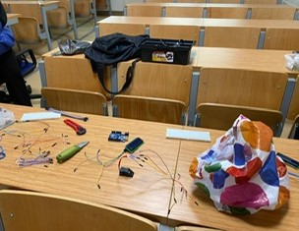
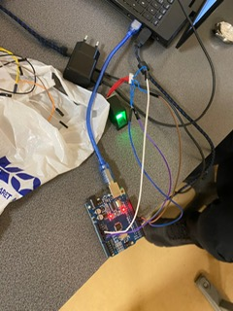
Materials Used
Arduino UNO
Fingerprint Sensor
20 jumper wire
Bread Board
4 Push Buttons
1 Red LED
16x2 LCD Screen
1k Resistor
Laptop
Buzzer

Slide 7
Equipment Part
We are using 4 push buttons. Our first push button is to enroll. Enroll key is used for enrollment of a new student into the system. So, when the user wants to enroll new finger then he or she needs to press the enroll button then the LCD asks for the ID, where the user wants to store the fingerprint image. The second button is the ok button. The user needs to press the ok button to proceed with selected ID. To select an ID, we use the third and fourth button to go up and down.

Slide 8
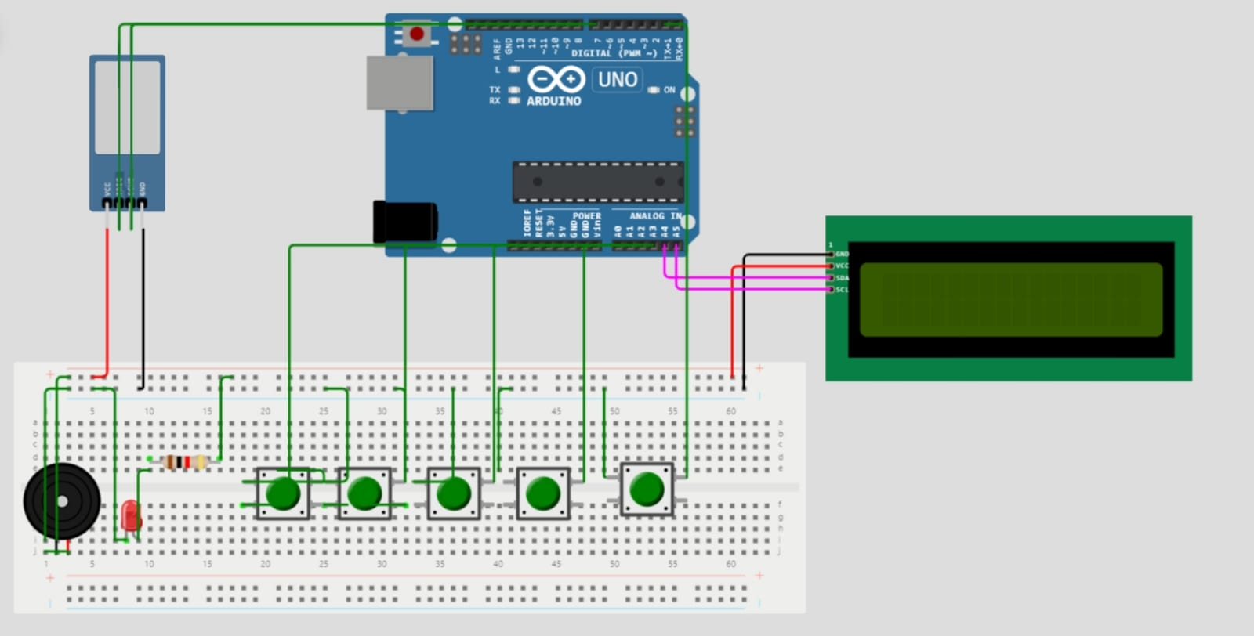
Circuit Diagram

Slide 9
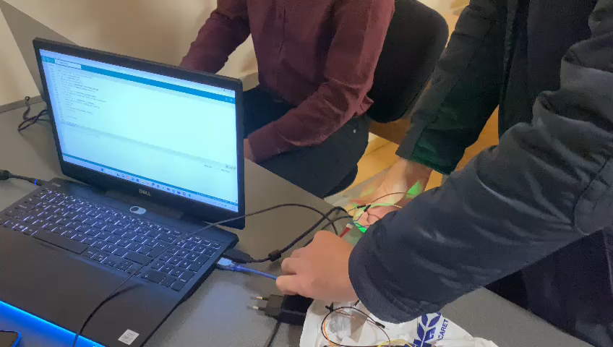
Recording Fingerprint

Slide 10
Conclusion
First, we identify the fingerprint. The code saves it, and the name is defined there. After the name is defined, when you have your fingerprint scanned at the beginning of the class, it perceives it as attendance and writes it to a text file and we can pull out the text file so that way we can take the attendance.

Slide 11
Thank You

